Slide 1
Innovative Ticket Sales Strategies, and Proven Practices to Fill Venues

Slide 2
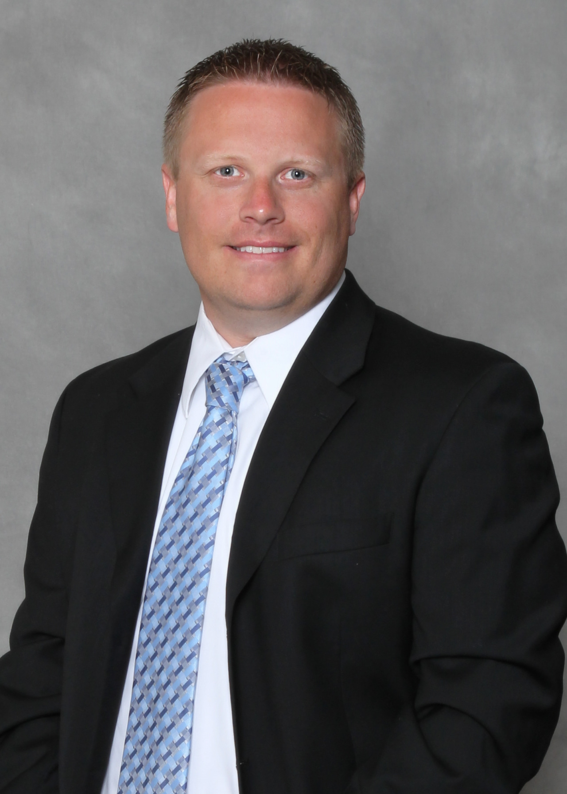
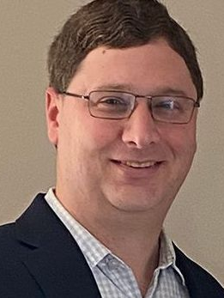
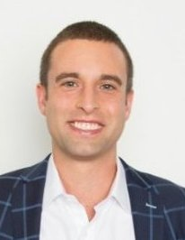
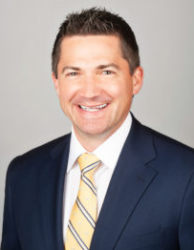
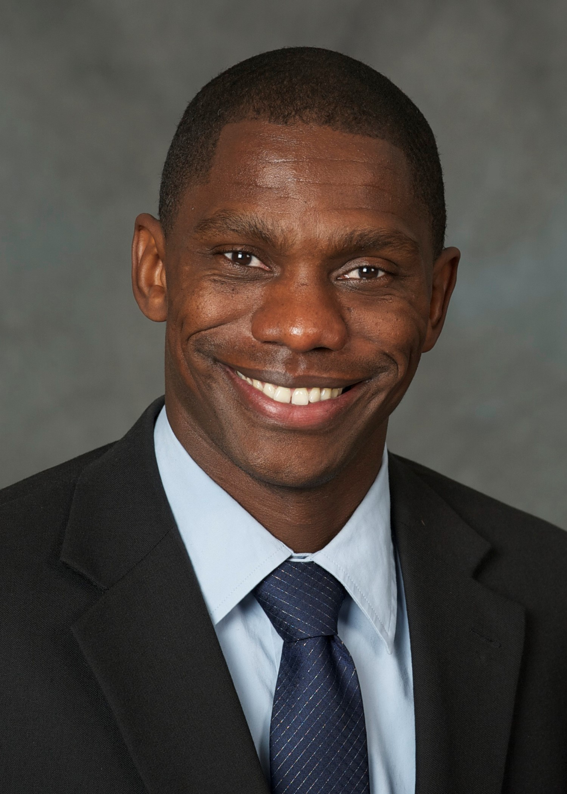
Jeff Robins
Josh Rose
Jake Bye
Kosha Irby
Adam Flack
Paciolan
Fevo
Amplify
Professional Bull Riders
Iowa Events Center

Slide 3
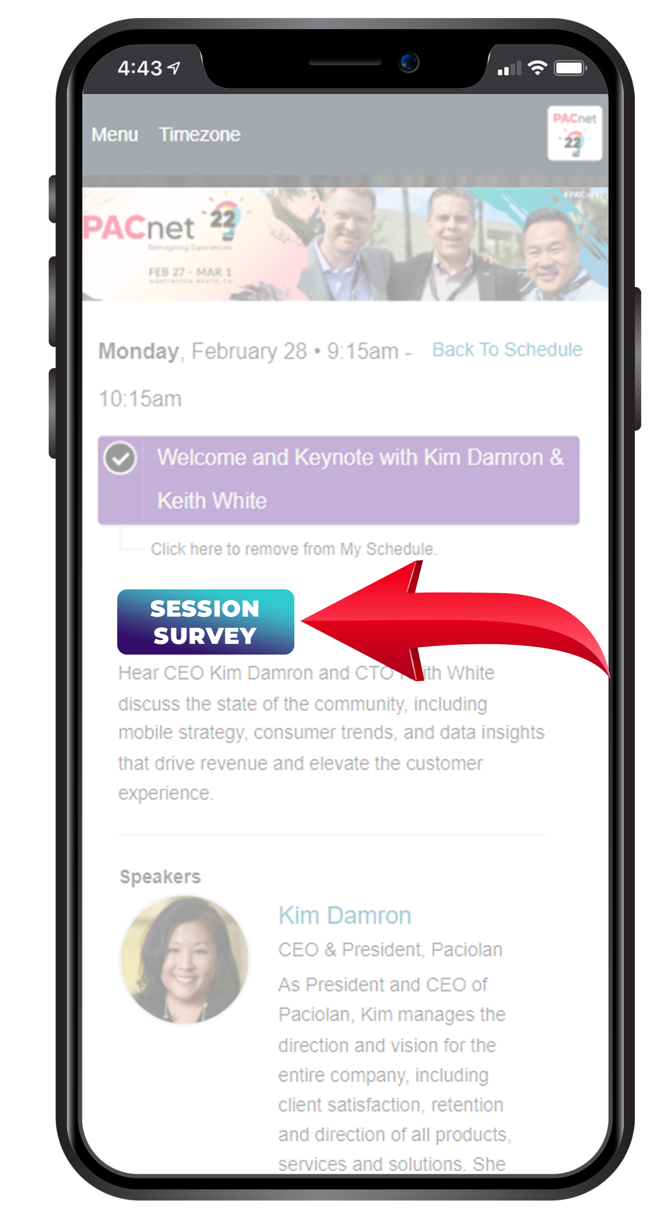
THANK YOU!
QUESTIONS?
Please complete the online session evaluation.

